Slide 1

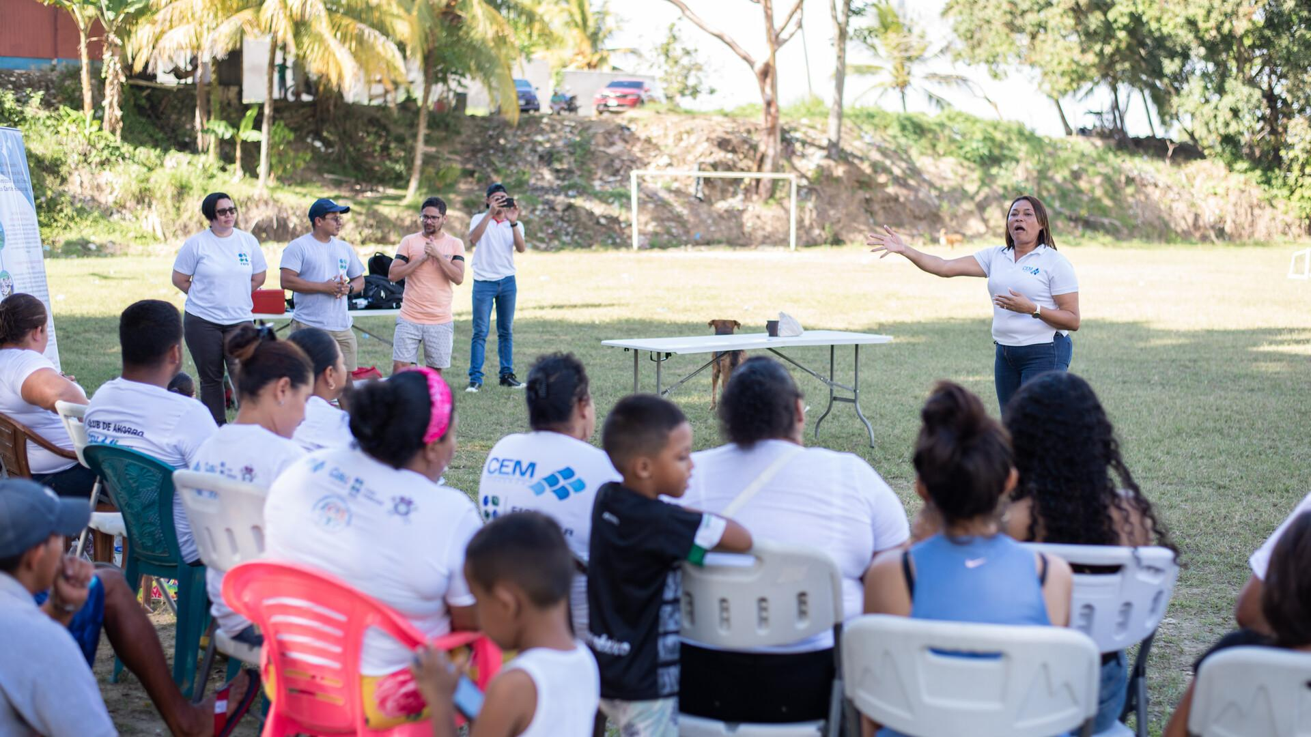
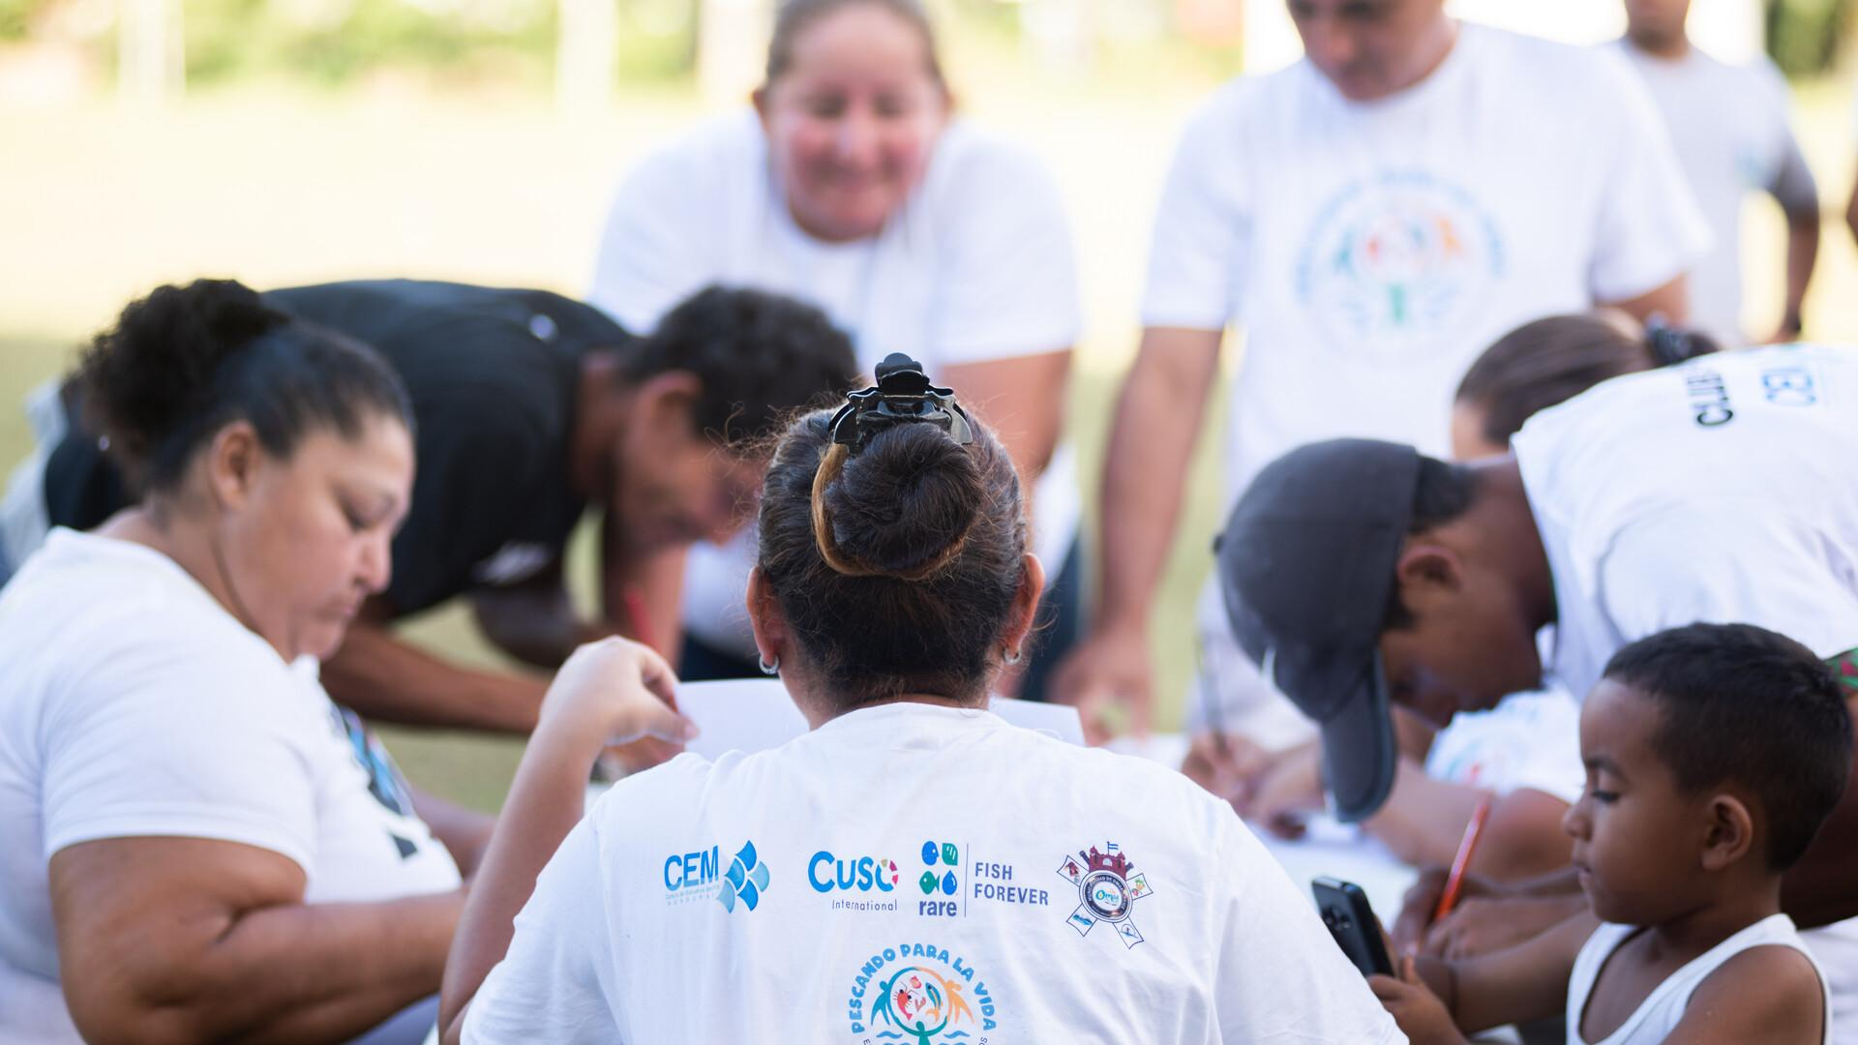



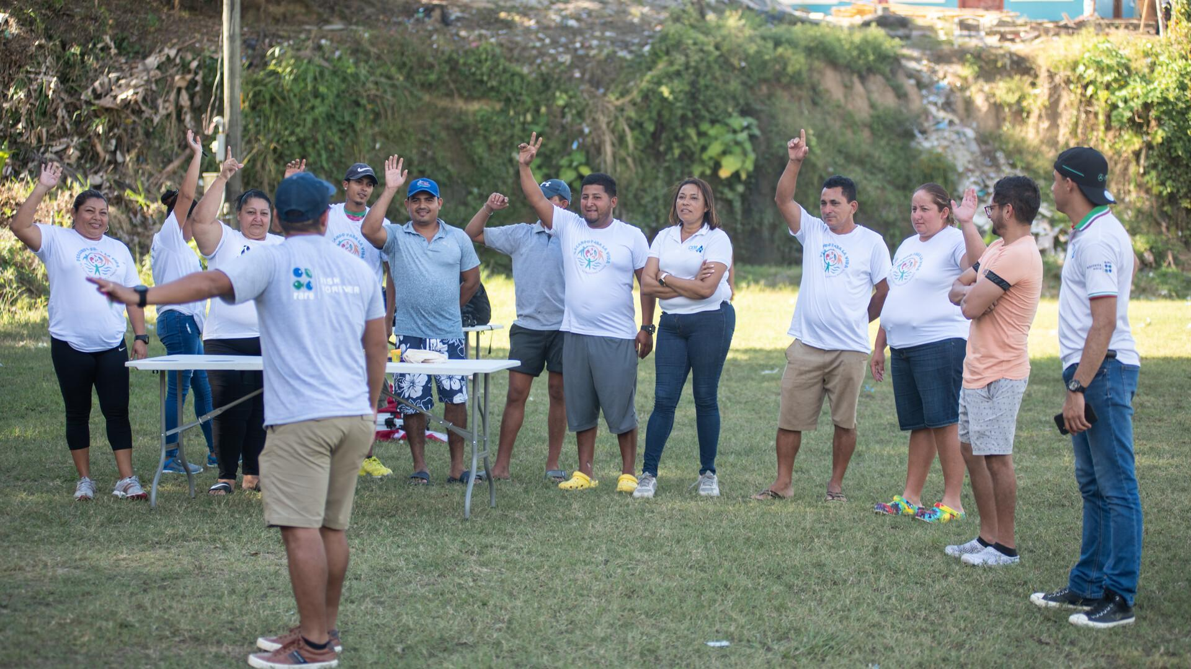

Project/ activity/ event name
Date: _____________________
Country or Team names:
Who led the activity? Who supported?
Place: (link to a Google maps pin, if possible)
Objective:
What where people intended to do as a result of this event/ activity?
Participants:
Who was the main audience? Why did they want to be there?
If you would like to learn more, contact [name] at [e-mail] or visit this [website].
Placeholder for your amazing picture!
Placeholder for your amazing picture!
Placeholder for your amazing picture!

Slide 2







Reflection
Impact
Tips
Tell us what was exciting/ satisfying/ inspiring/ surprising.
For best results use font size 12. If more than one add statements in bullets.
Describe how it contributes to thriving coastal communities and ecosystems.
For best results use font size 12. If more than one add statements in bullets.
If you had to do it again: what would you repeat, avoid, do more or less of?
For best results use font size 12. If more than one add statements in bullets.

Slide 3
To share the postcard delete this slide and convert to PDF.

